Slide 1
Lateral Flow
Testing at Home

Slide 2
Testing at Home
What has changed?
One LFT in college and one LFT at home each week
In college test – every MONDAY
Test at home – every THURSDAY – your first test at home will be tonight/tomorrow
Ideally leave enough time to complete your test at home before you come in to college on Thursday mornings. If you think you won’t have time you can do the test on a Wednesday evening.

Slide 3
Testing at Home
How to carry out the test at home
The following clip will demonstrate how to carry out the lateral flow tests at home and report your results.
https://www.youtube.com/playlist?list=PLvaBZskxS7tzQYlVg7lwH5uxAD9UrSzGJ

Slide 4
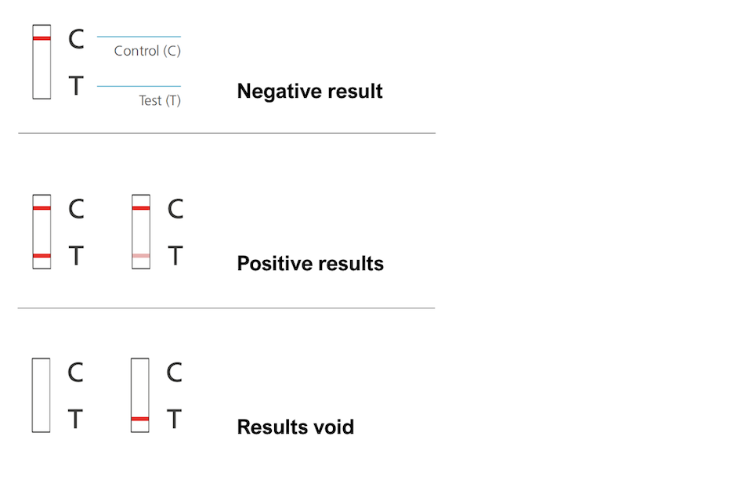
Testing at Home
How to read your results

Slide 5
Testing at Home
Reporting your results
By opening the home test kit you are agreeing to share the results with NHS Test and Trace.
Once you have completed your home test you must submit your results to NHS Test and Trace at www.gov.uk/report-covid19-result
You MUST also let us know the test result. This can be done via the Covid Test Result form on our website.

Slide 6
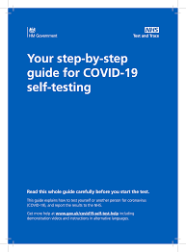
Testing at Home
What if I forget what to do?
Don’t worry about trying to remember all of this information. Your step-by-step guide for Covid-19 self-testing gives you all the information you need.

Slide 7
Testing at Home
How do I get my home test kit?
You will be issued with your 2 boxes of home test kits and guidance booklet later today
You will have to sign for the test kits
We have a record of which testing kits have been issued to each of you. All kits can be traced back to each student so you MUST make sure you take the kits home with you.
Your parents/guardians have been informed that you will be issued with your kits today, so know to expect them

Slide 8
Testing at Home
Your family/support bubble can get tested too
Only YOU can use the LFT kits that are issued to you.
BUT
Anyone in your household and/or support bubble can have lateral flow tests too.
They can request their own testing kits – information is on our website or on www.gov.uk

