Slide 1
ENLUTC Online Learning
Principal- Anesta McCullagh

Slide 2
Timetable
Structure/routine
Healthy body, healthy mind
Screen burn/challenges
Community
Safe

Slide 3
Timetable
Structure/routine
Healthy body, healthy mind
Screen burn/challenges
Community
Safe
Every day starts like this…
9am
30mins exercise
Mon, Wed, Thurs- Live ‘On Yer Mark’
Tues- your choice
Friday- Live Joe Wicks
After 14.30
Project work
4 challenges (chose at least one to take part in)
Tutor calls one/week
Physical challenge
Fun challenge
Brain challenge
Reading challenge
**starts from next week
Times of the online day
9-9.30 exercise
9.30-9.45 drink and change
Period 1 9.45-10.30
Break/Assembly(Live) 10.30-11.00
Period 2 11.00-12.00
Period 3 12.00-13.00
Lunch 13.00-13.30
Period 4 13.30-14.30

Slide 4
Timetable
Structure/routine
Healthy body, healthy mind
Screen burn/challenges
Community
Safe
Live
(Live)
Monday- Maths and Physics
Tuesday- English and Engineering
Wednesday-Some Options
Thursday- some Options and Chemistry
Times of the online day
9-9.30 exercise
9.30-9.45 drink and change
Period 1 9.45-10.30
Break/Assembly(Live) 10.30-11.00
Period 2 11.00-12.00
Period 3 12.00-13.00
Lunch 13.00-13.30
Period 4 13.30-14.30
Variety
Live online lessons
Pre-recorded lessons
Resourced lessons using online apps

Slide 5
Timetable
Structure/routine
Healthy body, healthy mind
Screen burn/challenges
Community
Safe

Slide 6
Timetable
Live Assembly once per week
Whole Year group
Celebrate the year group’s success with the weekly challenges and projects
Staff nominations for excellent effort and/or work
Any additional exciting opportunities for you to get involved in for the next
Weekly notices from staff

Slide 7
Timetable
Structure/routine
Healthy body, healthy mind
Screen burn/challenges
Community
Safe
Weekly phonecall from your tutor

Slide 8
How will this look?

Slide 9
How will this look?

Slide 10
How will this look?

Slide 11
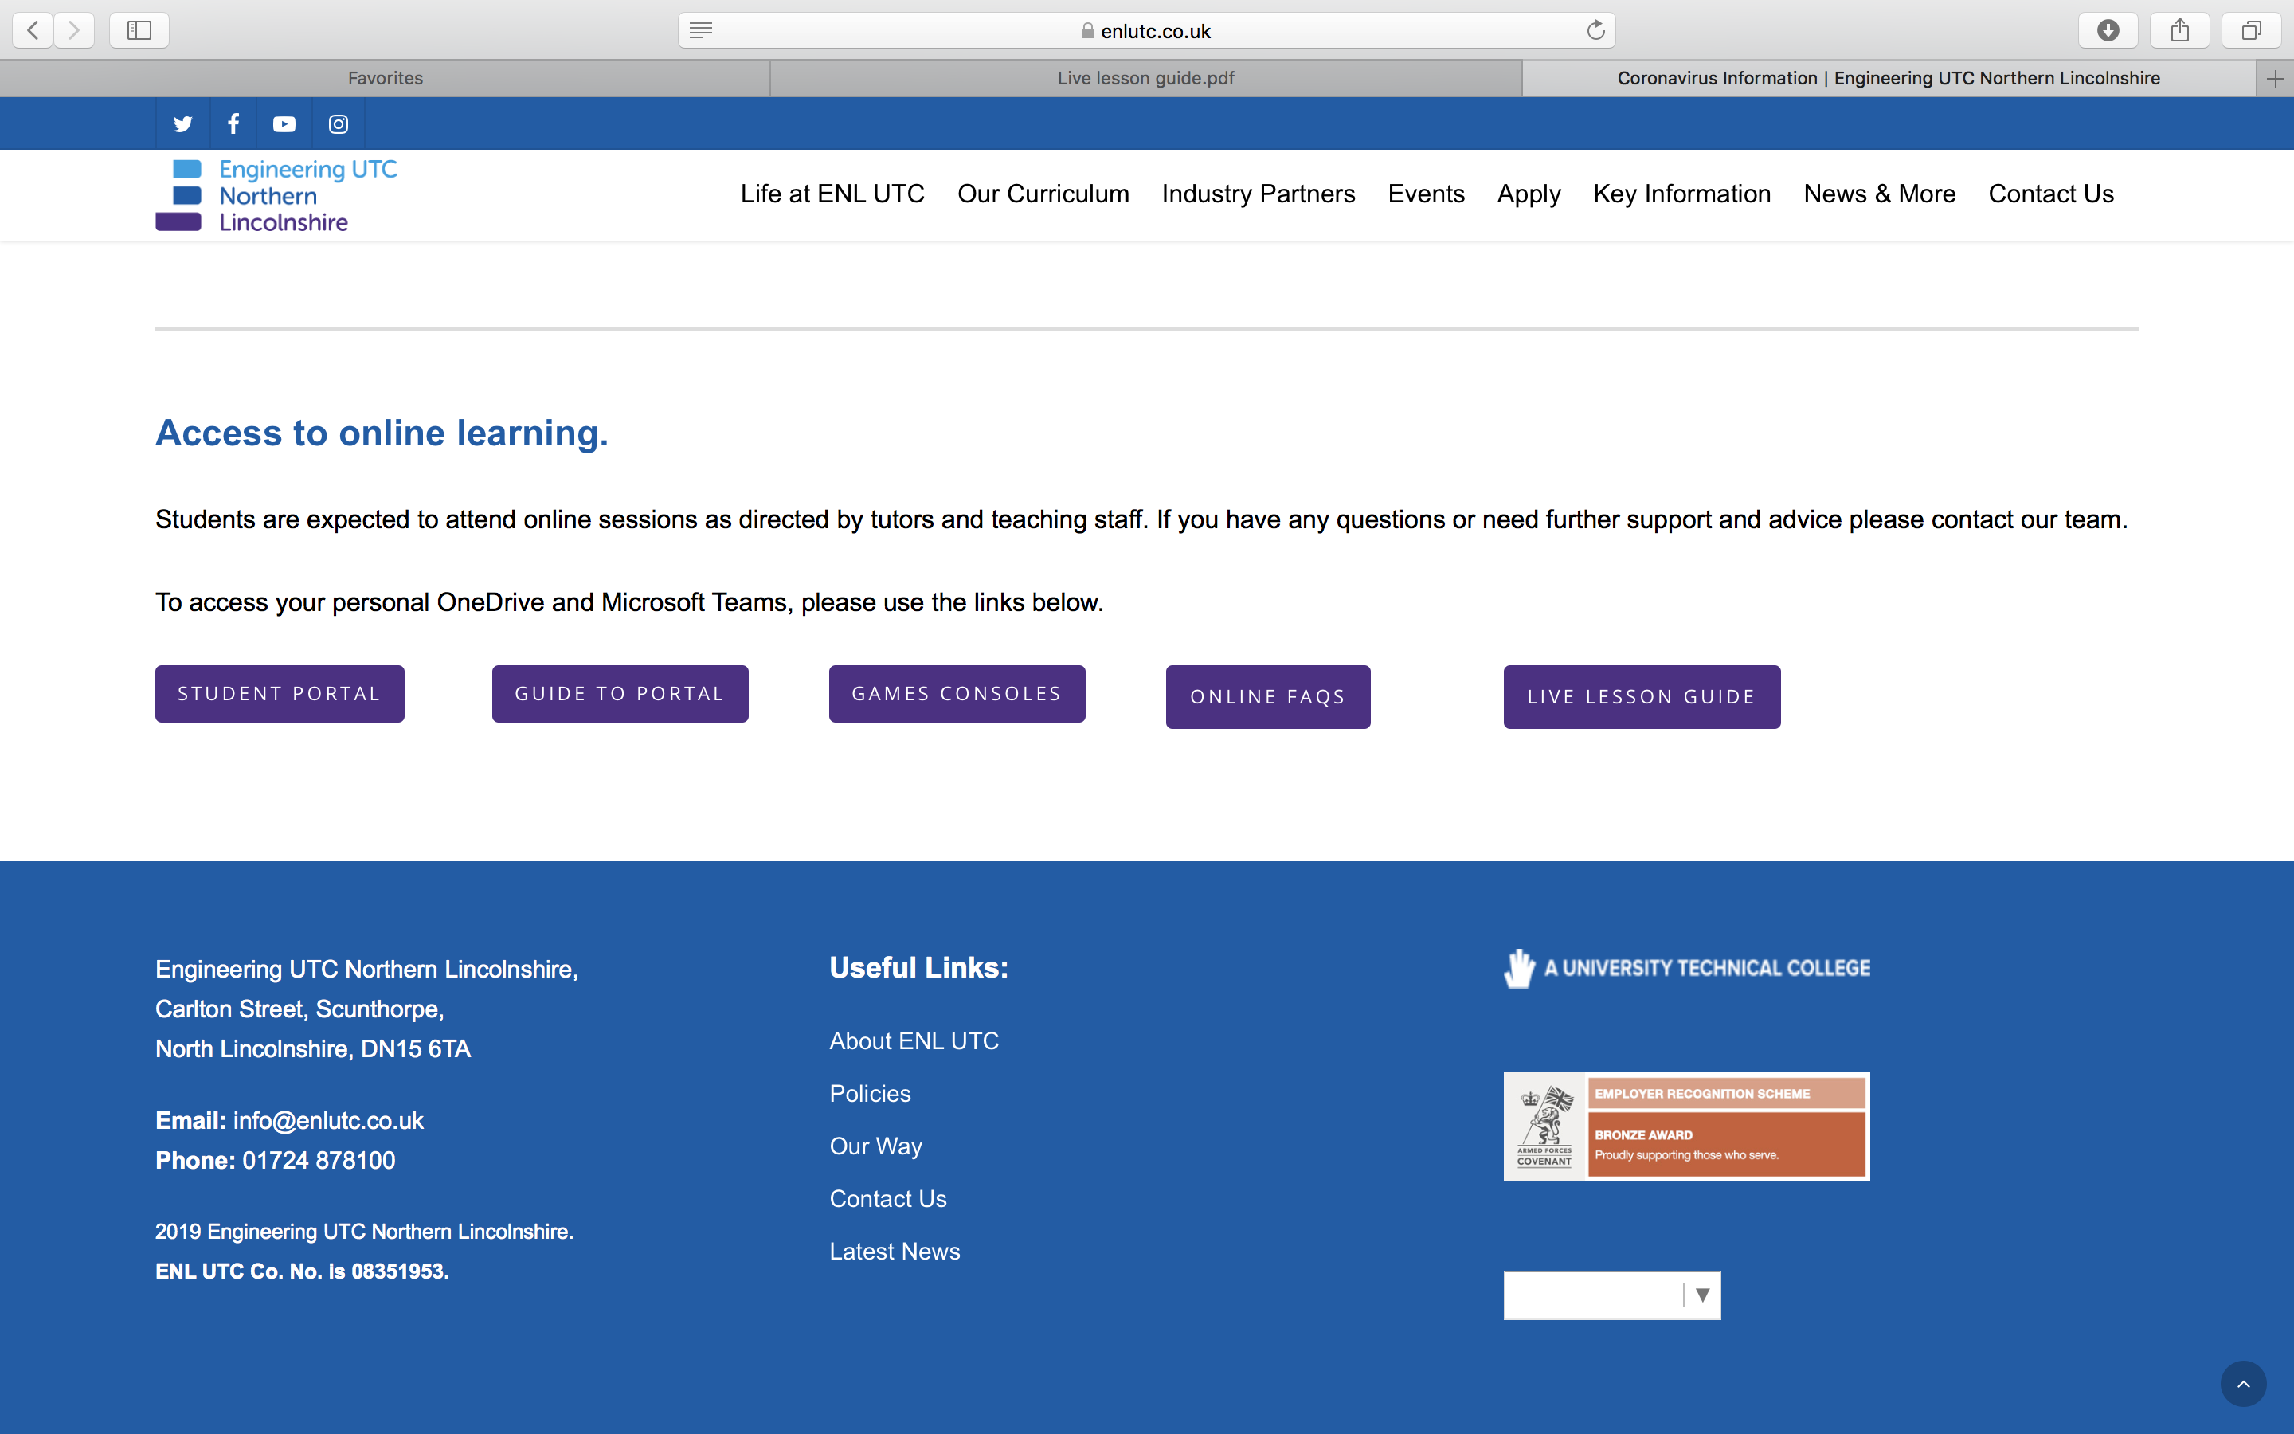

Slide 12
How will this look?

Slide 13
Timetable
Structure/routine
Healthy body, healthy mind
Screen burn/challenges
Community
Safe

Slide 14
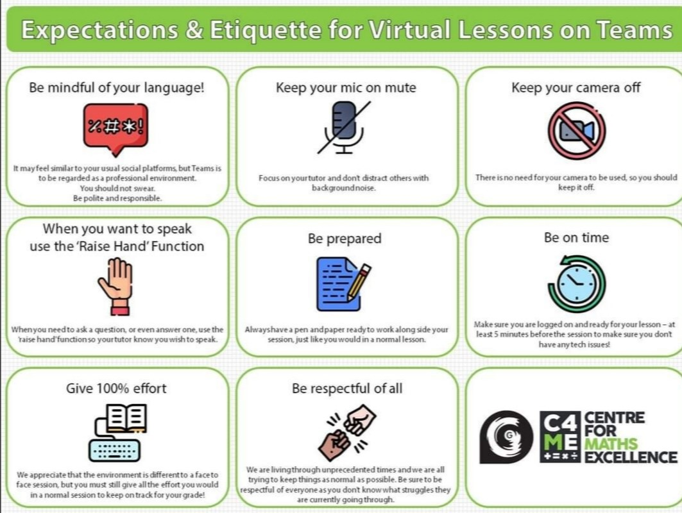

Slide 15
How will this look?

Slide 16
Live Lesson Verbal Reminder
The following microscript could be used:
Good morning/afternoon. This is a reminder that this live meeting will be recorded for safeguarding purposes, but will not be shared outside of ENL UTC. I will begin recording now. Please could everyone mute their microphones to reduce background noise and ensure they are in a suitable location to work.. Please use the hands up feature or the chat function if you have a question linked to the learning. However, professional standards must be adhered to. Please use formal, professional language, as you would in a classroom, and be reminded that videos and photography is not permitted. Are there any questions before we begin?

Slide 17
How will this look?

Slide 19
Parental Expectations
Online Learning
Each day, staff will set work, in accordance with the online learning timetable. To support with this, parents and carers should ensure the following:
Your child is available and contactable throughout the school day
Your child completes the work set by their teachers, completing it to the best of their ability before submission and asking for support should they need it
Reinforce the importance of professionalism, such as language appropriate for the workplace in messages, setting work out clearly, and working in an environment that best supports learning.
Make school aware if their child is sick or otherwise cannot complete work
Seek help from the UTC if it is needed
Ensure that their child behaves appropriately online and supports the UTC if consequences for poor behaviour need to be given.

Slide 20
ENLUTC Supporting Parents
Attendance to live session
Lack of work completed
Staff nominations

Slide 21
Student Expectations
Online ‘live’ lessons
There may be instances where live lessons or meetings are offered. Ensure the guidance for ‘Remote Learning’ is adhered to, as well as the following:
Arrive on time for any online live learning
Ensure you are dressed appropriately and are in an appropriate setting, where there is limited noise or distraction.
Use your first and second name as your online name
Ensure your microphone is turned off to limit interference
Ensure your own camera is turned off. If, for any reason, it needs to be on, a background should be used.
All online sessions will be recorded by the staff member leading it. At the start of each session, they will remind you of this, as well as a brief overview of expectations. Maintain full professional conduct during this time.
If you have a question, use the ‘raise hand’ function
Be professional in your conduct in the chat function, as well as if you are speaking. No videos or images are permitted to be taken.

Slide 22
Student Expectations
Remote Learning
Be professional, responsible and loyal to the UTC values when learning remotely (via Microsoft Teams), in the following ways:
Be contactable during the school day, following the timetable and completing the work set on it
Complete work set for each and every lesson and subject to the best of your ability
Seek help and support if needed to complete the work set. Do not just leave tasks incomplete.
Alert teacher or Head of Year to any issues you experience, such as not being able to access the work online
Behave appropriately online, including in messages to staff or in any online group forums that may appear. This includes using professional language, suitable for a workplace.
When submitting work, ensure your name, date, subject and title is included. Always answer in full sentences, that make sense without the task, unless directed otherwise. If there are a series of tasks or questions, ensure these are labelled.

Slide 23
Your feedback is important
Friday feedback survey
Quantity of work?
Challenge of work?
Easy to access?
Staff helpful?
Supportive?
Future suggestions?

Slide 24
We are here to help
Phonelines open from 8.30-2pm Monday to Friday 01724878100
Out of hours we respond to an email oncall@enlutc.co.uk
IT issues email support@primaryictsupport.co.uk
Message teachers about work through Teams
Website- under Covid tab on the front page is an area dedicated to online learning
Facebook page is always updated with the latest information
Messages for year groups is through the isolation Team in the Teams groups
**No question is too silly, we are here to help, ask away!

